Slide 1

Cleaned & Refined Messy Rows Dataset
Data Cleaning Project
Project Type: Data Cleaning & Transformation

Slide 2

Power Query
Project Overview
01.
03.
02.
Ensured accuracy, clarity, and consistency across fields
04.
Real-world messy dataset cleaning & transformation
Converted raw, unstructured data → analysis-ready format
Solved duplicate columns, casing, nulls, city fragments, data types

Slide 3
Problem Statement
1
2
Business decisions depend on clean and accurate data
Raw datasets contain errors, inconsistencies, structural problems
Problems
3
4
Issues lead to wrong results, poor decisions, wasted effort
Goal: Automate cleaning with Power Query to improve efficiency

Slide 4
Power Query
Data Issues Identified
01.
03.
Duplicate and unnecessary columns
Blank and null values in key fields
02.
Merged cells with unrelated data
Columns arranged in random, non-logical order
04.
Inconsistent text formatting
City names split into multiple columns
Incorrect data types (e.g., text stored as numbers)

Slide 5



Step-by-Step Cleaning – Part 1
1. Convert raw dataset into Excel table
5. Apply Capitalize Each Word for consistency
2. Remove duplicate and blank columns
6. Split merged columns using delimiter
3. Import into Power Query Editor
4. Merge fragmented city columns (e.g., 'New'+'York')
7. Handle missing values with N/A or placeholders

Slide 6
Step-by-Step Cleaning – Part 2
8. Use 'Columns from Examples' for extraction
11. Ensure uniformity in IDs and Emails
9. Reorder fields logically (IDs → Names → Contact → Location → Metrics)
12. Export final clean dataset into Excel workbook
10. Detect and assign correct data types
- Dataset now analysis-ready

Slide 7




Tools & Technologies Used
1. Advanced Excel – For table creation, exporting
2. Power Query – For automating cleaning & transformations
Power Query
3. Data Profiling Tools – For detecting nulls, duplicates, inconsistencies

Slide 8





Files in Repository
Cleaned & Refined Messy Rows Dataset.pdf – Cleaning steps documentation
Messy Employee Dataset 2000.csv – Raw dataset (CSV format)
Messy Employee Dataset 2000.xlsx – Raw dataset (Excel format)
Data Cleaning.png – Snapshot of cleaned dataset

Slide 9
Power Query
Key Learning Outcomes
01.
03.
Practical Power Query application for messy datasets
02.
Detecting and assigning correct data types
Automation of repetitive cleaning tasks
04.
Ability to convert messy, unstructured data into clean dataset
Improved efficiency and accuracy in reporting
Skills in text case standardization & null handling

Slide 10




Future Enhancements
Automate entire process using Power BI Dataflows
Add custom validation rules for incoming data
Build Power BI dashboard to visualize before-and-after results

Slide 11


Project Overview

Slide 12

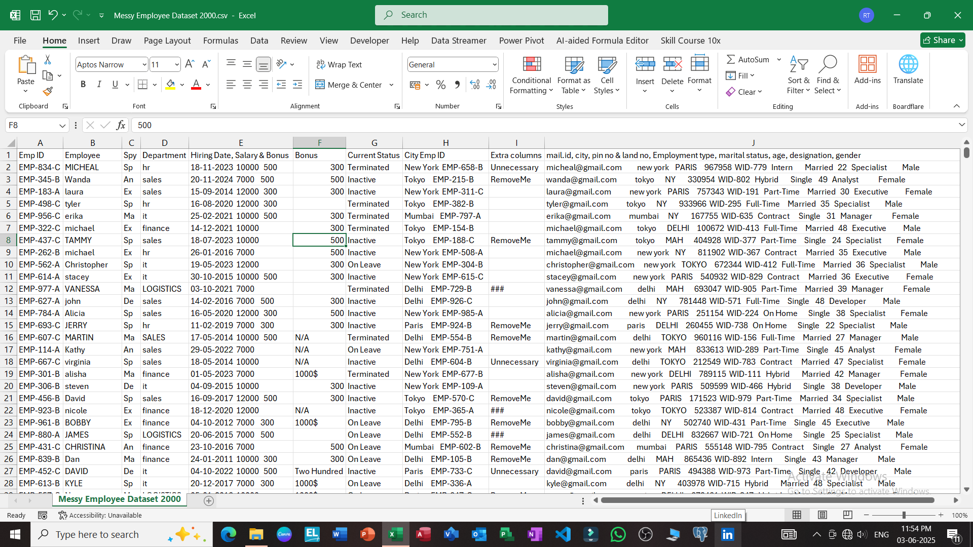
Unorganized Raw Data
35%

Slide 13
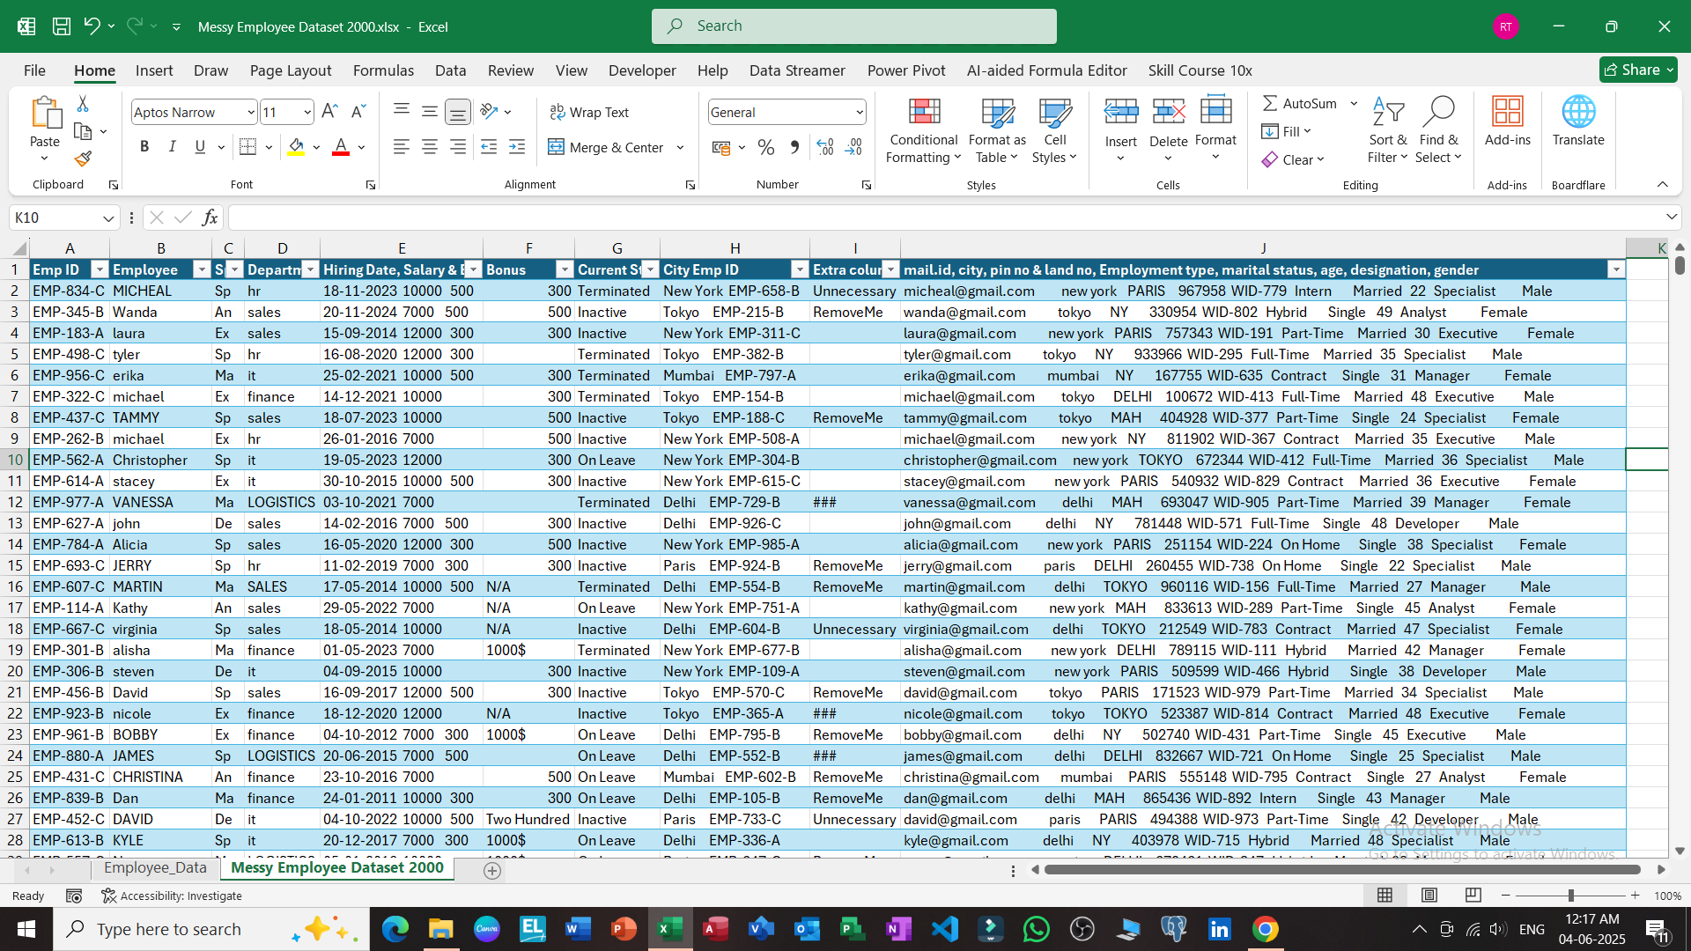
After converting into a table
35%

Slide 14
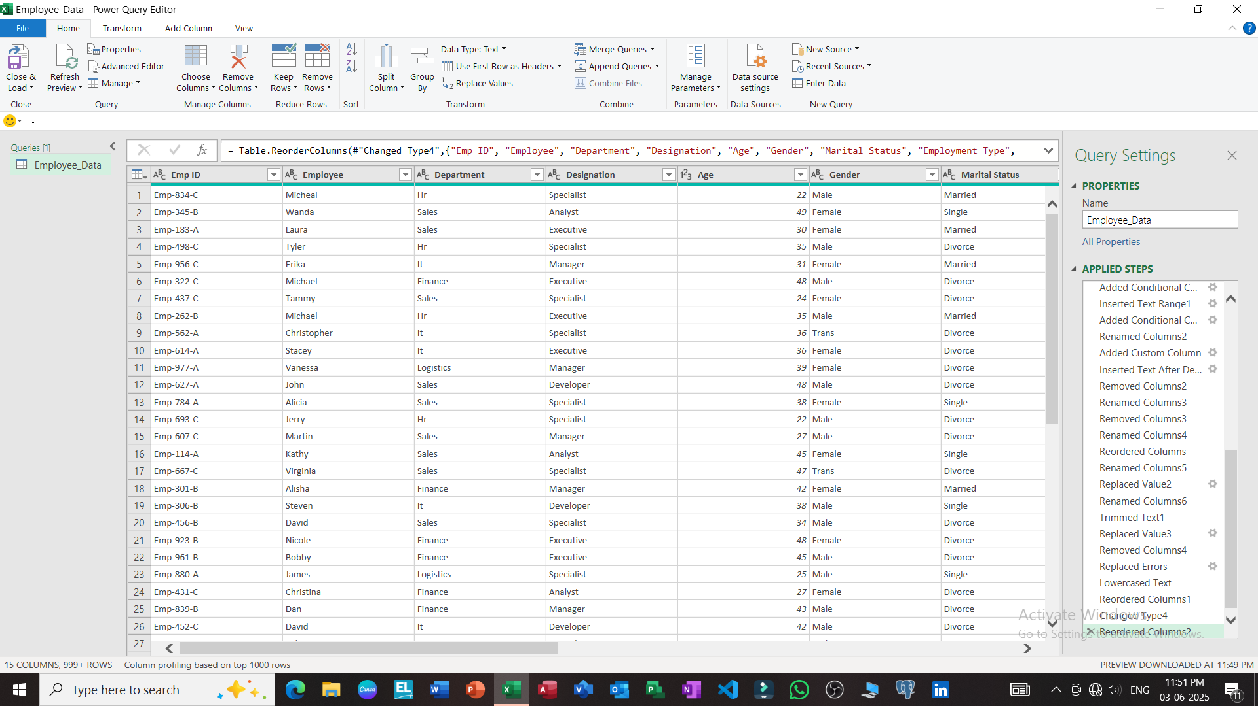
After cleaning the data 1
35%

Slide 15
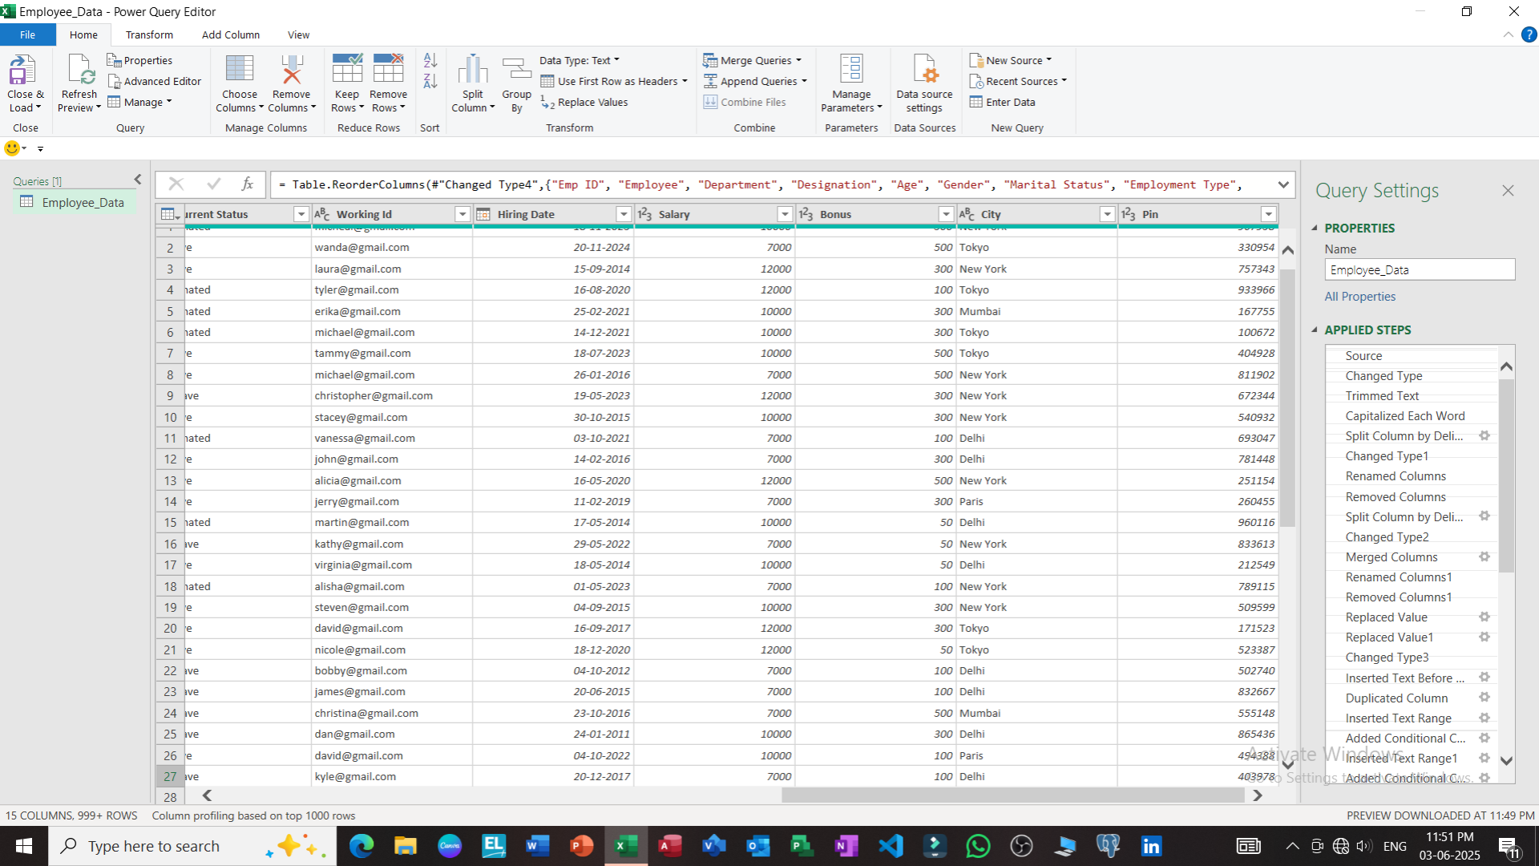
After cleaning the data 2
35%

Slide 16
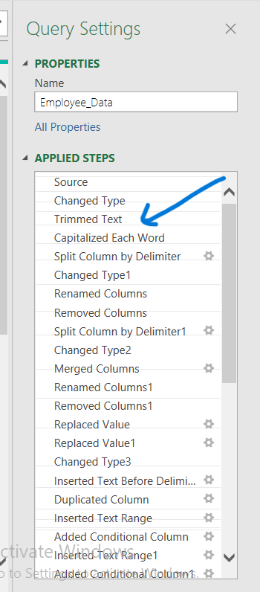
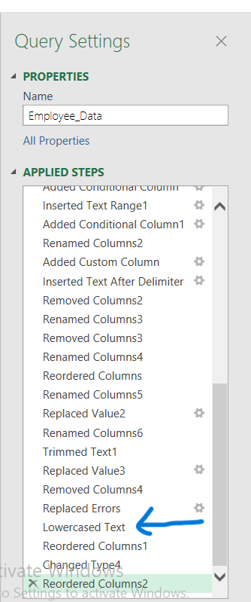
Steps executed in Power Query
35%

Slide 17
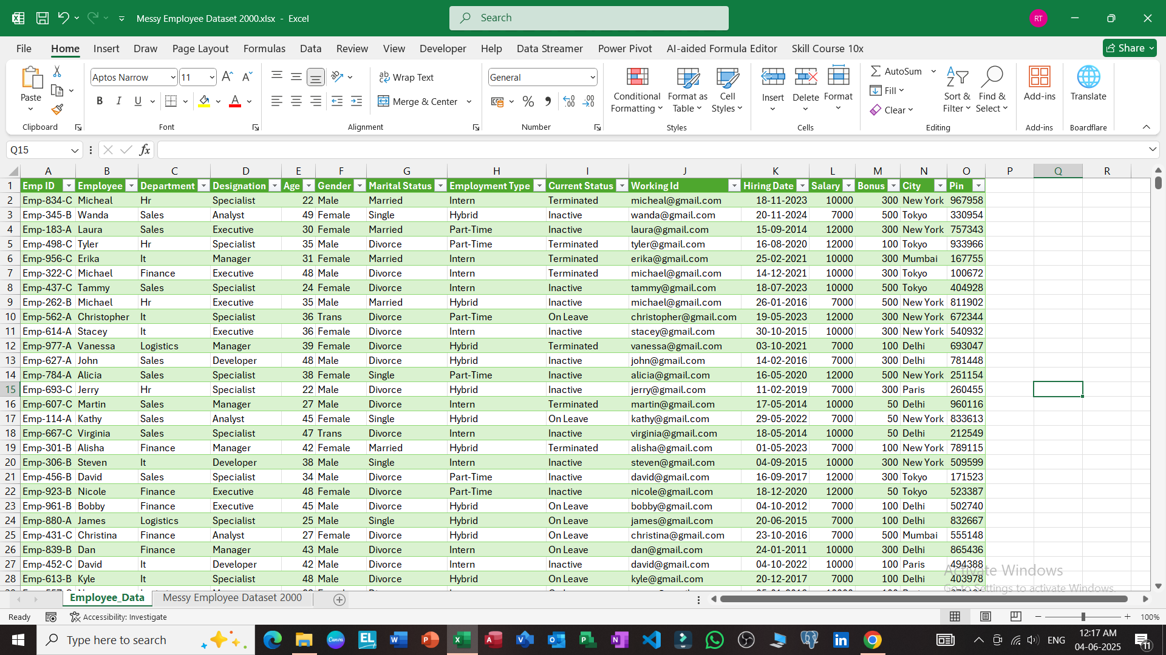
Data cleaned and loaded successfully
35%

Slide 18
Power Query
Project
Thank you!
Every great presentation is complete with a great audience — and that’s you!

